Slide 1

Financial Analytics
Manoel Fernando Alonso Gadi Associate Professor
manoelgadi@campusciff.net
Sesión 2 - Analítica para individuos - Crédito y Fraude
Madrid

Slide 2
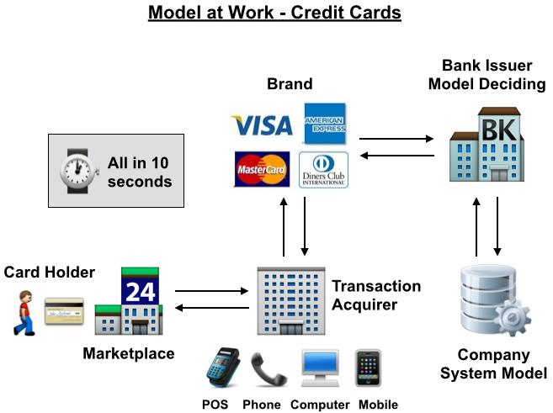

Slide 3
APPLICANTS
DECISION
ACCEPTS
REJECTS

Slide 4
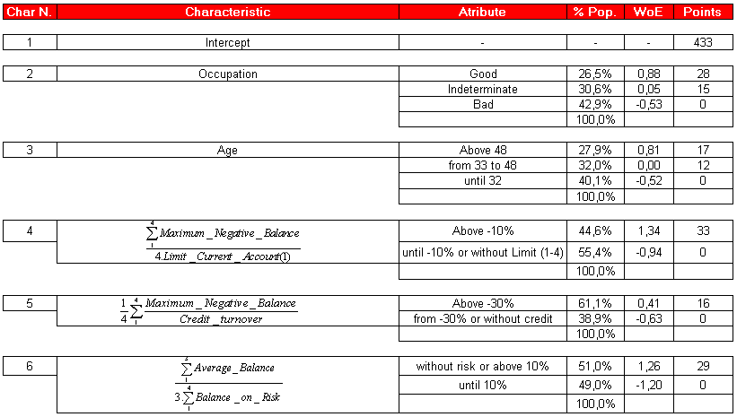
A simple model - example
Rule can be: accepts if score > 500

Slide 5
GOODS
BADS
DECISION
ACCEPTS: GOODS
ACCEPTS: BADS
REJECTS: GOODS
REJECTS: BADS

Slide 6
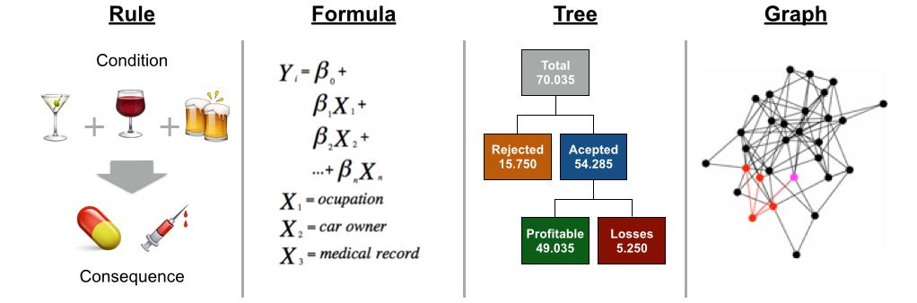
Model shapes

Slide 7
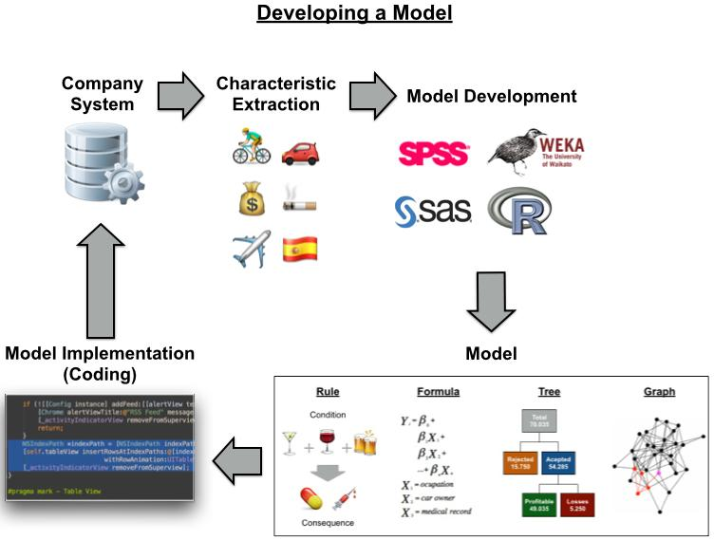


Slide 8
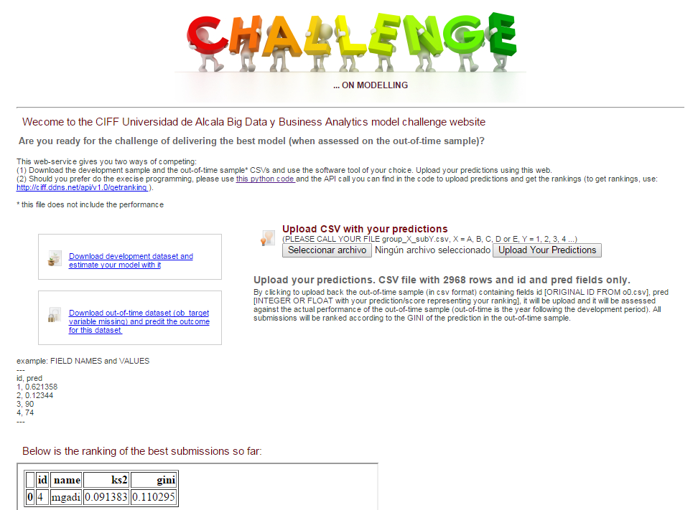
Generalized Linear Model Regression Results
==============================================================================
Dep. Variable: ob_target No. Observations: 593
Model: GLM Df Residuals: 514
Model Family: Binomial Df Model: 78
Link Function: logit Scale: 1.0
Method: IRLS Log-Likelihood: -155.12
Date: Fri, 10 Oct 2014 Deviance: 310.24
Time: 17:11:43 Pearson chi2: 726.
No. Iterations: 26
==============================================================================
coef std err t P>|t| [95.0% Conf. Int.]
------------------------------------------------------------------------------
if_var_81 -0.0965 0.150 -0.643 0.520 -0.390 0.197
if_var_80 -4.19e+06 6.29e+06 -0.667 0.505 -1.65e+07 8.13e+06
ib_var_21 0.3136 0.976 0.321 0.748 -1.598 2.226
ib_var_20 0.0080 1.454 0.006 0.996 -2.842 2.858
ico_var_51 0.3043 0.215 1.413 0.158 -0.118 0.727
ico_var_50 0.2798 0.332 0.843 0.399 -0.371 0.931
ico_var_53 -0.7005 0.307 -2.282 0.022 -1.302 -0.099
ico_var_52 0.2085 0.206 1.014 0.310 -0.194 0.611
ico_var_55 -0.2220 0.305 -0.727 0.467 -0.820 0.376
ico_var_54 -0.2241 0.218 -1.027 0.304 -0.652 0.204
ico_var_57 0.0680 0.221 0.308 0.758 -0.365 0.501
ico_var_56 0.5072 0.250 2.032 0.042 0.018 0.996
ico_var_59 0.0630 0.268 0.235 0.814 -0.463 0.589
ico_var_58 -0.0561 0.244 -0.230 0.818 -0.535 0.423
ico_var_25 0.2703 0.341 0.792 0.428 -0.399 0.939
ico_var_26 0.3858 0.356 1.083 0.279 -0.313 1.084
ico_var_27 0.9745 0.371 2.627 0.009 0.247 1.702
ico_var_28 0.1577 0.331 0.476 0.634 -0.492 0.807
ico_var_29 -0.6224 0.324 -1.921 0.055 -1.257 0.013
ico_var_64 0.1559 0.324 0.481 0.631 -0.480 0.791
if_var_65 -0.0057 0.025 -0.232 0.816 -0.054 0.043
ico_var_60 0.2065 0.268 0.772 0.440 -0.318 0.731
ico_var_61 -0.1859 0.301 -0.617 0.537 -0.776 0.404
ico_var_62 -0.2433 0.204 -1.191 0.234 -0.644 0.157
ico_var_63 0.0180 0.226 0.080 0.937 -0.424 0.460
ib_var_6 0.0857 0.385 0.222 0.824 -0.670 0.841
ib_var_7 1.5941 1.246 1.279 0.201 -0.848 4.037
ib_var_4 -0.0688 0.466 -0.148 0.883 -0.982 0.844
ib_var_9 -0.0006 0.001 -0.800 0.424 -0.002 0.001
ib_var_2 -0.0068 0.503 -0.013 0.989 -0.993 0.979
if_var_67 -0.0180 0.034 -0.534 0.593 -0.084 0.048
ib_var_1 -0.9487 1.061 -0.894 0.371 -3.029 1.132
if_var_66 0.3556 5215.921 6.82e-05 1.000 -1.02e+04 1.02e+04
icn_var_23 -0.1955 0.181 -1.077 0.281 -0.551 0.160
icn_var_22 -0.2774 0.277 -1.002 0.316 -0.820 0.265
ib_var_8 25.6578 1.3e+05 0.000 1.000 -2.55e+05 2.55e+05
icn_var_24 0.3971 0.262 1.516 0.130 -0.116 0.911
ib_var_5 -2.0353 0.894 -2.276 0.023 -3.788 -0.283
ib_var_3 0.7080 1.455 0.487 0.626 -2.143 3.559
ico_var_37 -1.252e+05 1.83e+05 -0.684 0.494 -4.84e+05 2.33e+05
ico_var_36 -0.0975 0.046 -2.129 0.033 -0.187 -0.008
ico_var_35 -0.0077 0.029 -0.261 0.794 -0.065 0.050
ico_var_34 -0.0258 0.049 -0.526 0.599 -0.122 0.070
ico_var_33 0.0064 0.059 0.108 0.914 -0.110 0.122
ico_var_32 -0.2348 0.310 -0.756 0.450 -0.843 0.374
ico_var_31 -0.2394 0.261 -0.918 0.358 -0.750 0.272
ico_var_30 0.4566 0.323 1.414 0.157 -0.176 1.090
if_var_69 -2.05e-05 2.52e-05 -0.813 0.416 -6.99e-05 2.89e-05
if_var_68 0.0002 6.85e-05 2.724 0.006 5.23e-05 0.000
ico_var_39 -1.252e+05 1.83e+05 -0.684 0.494 -4.84e+05 2.33e+05
ico_var_38 -1.252e+05 1.83e+05 -0.684 0.494 -4.84e+05 2.33e+05
ib_var_18 0.1319 0.887 0.149 0.882 -1.606 1.870
ib_var_19 -1.7831 0.901 -1.979 0.048 -3.549 -0.018
ib_var_14 1.4699 0.838 1.754 0.079 -0.172 3.112
ib_var_15 -0.0340 1.144 -0.030 0.976 -2.277 2.209
ib_var_16 0.7681 1.186 0.648 0.517 -1.557 3.093
ib_var_17 -0.3055 0.827 -0.369 0.712 -1.927 1.316
ib_var_10 -25.6468 5.87e+05 -4.37e-05 1.000 -1.15e+06 1.15e+06
ib_var_11 -25.0367 1.3e+05 -0.000 1.000 -2.55e+05 2.55e+05
ib_var_12 -37.8555 5.22e+05 -7.26e-05 1.000 -1.02e+06 1.02e+06
ib_var_13 0.5777 0.731 0.790 0.429 -0.855 2.010
if_var_76 -0.0325 0.062 -0.523 0.601 -0.155 0.089
if_var_77 3.755e+06 5.49e+06 0.684 0.494 -7e+06 1.45e+07
if_var_74 -0.2214 0.173 -1.278 0.201 -0.561 0.118
if_var_75 0.0167 0.069 0.244 0.807 -0.118 0.151
if_var_72 0.0331 0.096 0.344 0.731 -0.156 0.222
if_var_73 0.0288 0.018 1.582 0.114 -0.007 0.065
if_var_70 0.1340 0.102 1.316 0.188 -0.066 0.334
if_var_71 -0.0780 0.105 -0.747 0.455 -0.283 0.127
if_var_78 -0.0129 0.029 -0.451 0.652 -0.069 0.043
if_var_79 0.0001 5.88e-05 2.444 0.015 2.85e-05 0.000
ico_var_42 -1.252e+05 1.83e+05 -0.684 0.494 -4.84e+05 2.33e+05
ico_var_43 1.397e+05 2.1e+05 0.667 0.505 -2.71e+05 5.5e+05
ico_var_40 -1.252e+05 1.83e+05 -0.684 0.494 -4.84e+05 2.33e+05
ico_var_41 -1.252e+05 1.83e+05 -0.684 0.494 -4.84e+05 2.33e+05
ico_var_46 1.397e+05 2.1e+05 0.667 0.505 -2.71e+05 5.5e+05
ico_var_47 1.397e+05 2.1e+05 0.667 0.505 -2.71e+05 5.5e+05
ico_var_44 1.397e+05 2.1e+05 0.667 0.505 -2.71e+05 5.5e+05
ico_var_45 1.397e+05 2.1e+05 0.667 0.505 -2.71e+05 5.5e+05
ico_var_48 1.397e+05 2.1e+05 0.667 0.505 -2.71e+05 5.5e+05
ico_var_49 -0.0611 0.308 -0.198 0.843 -0.666 0.543
==============================================================================
Learning from example with Python
print "IMPORTING LIBRARIES..."
import pandas as pd
import numpy as np
import statsmodels.api as sm
import re
import requests
from requests.auth import HTTPBasicAuth
print "DOWNLOADING DATASETS..."
df = pd.read_csv("https://dl.dropboxusercontent.com/u/28535341/dev.csv") #DEV-SAMPLE
dfo = pd.read_csv("https://dl.dropboxusercontent.com/u/28535341/oot0.csv")#OUT-OF-TIME SAMPLE
print "IDENTIFYING TYPES..."
in_model = []
list_ib = set() #input binary
list_icn = set() #input categorical nominal
list_ico = set() #input categorical ordinal
list_if = set() #input numerical continuos (input float)
list_inputs = set()
output_var = 'ob_target'
...
https://dl.dropboxusercontent.com/u/28535341/ciff_dev_sample.py

Slide 9
Learning from example with Python
Simply getting a dataset and using a software tool (either SAS, SPSS, Weka, R or Python) to fit a model will certainly deliver a bad model. That’s why Data Scientists are so important and sometimes they are consider artists (Sexy, isn’t it?).
My objective as professor in this course is to help you guys to learn some data analysis applied to Financial Institutions always seeking to understand why and to minimize the difference between the GINI DEVELOPMENT and GINI HOLD OUT

Slide 10



The competitive advantage of using Scorecards explained with history
Richard Fairbank
Nigel Morris (former FICO specialists)
Expert/
Judgmental
Scores were introduced
1980’s
Statistical Scoring were introduced (1989 FICO score were started to be sold to the market)
1988
1956
Scores: Mass reproducing ratios (Best Credit Analysts knowledge)
Successful company founded on analytical foundations using scores
Virginia Based Signet Banking Corporation
Credit Analysts judged credit based on experience and knowing their customer on 1:1 basis
Why introduce scores?
to improve bad debt trade-off
to reduce bad debt
to increase business volume
to maximize profit
to improve operational efficiencies
to obtain better control
to meet regulation requirements

Slide 11
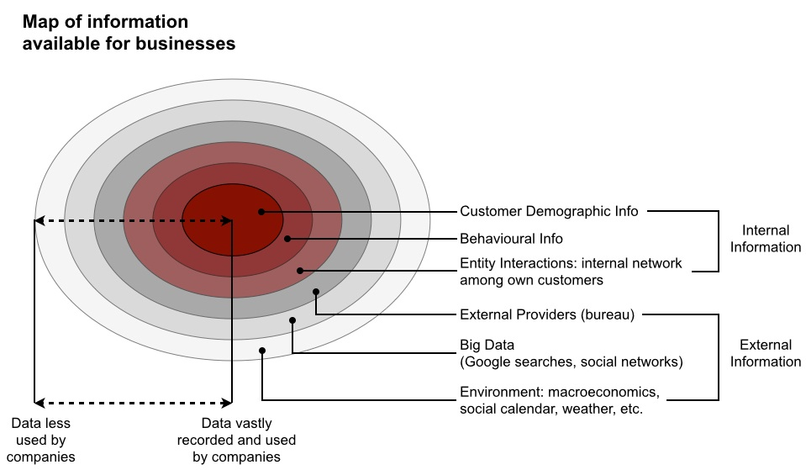
Type of information and type variables...

Slide 12
Type of information and type variables...
Input (explanatory)
Output (target)
Binary: - Has a bank account? Yes (1) or NO (0)
Categorical Ordinal:
- Years of age
Categorical Nominal:
- International telephone code of country of origin?
+1
+34
Continuous:
- Salary

Slide 13
Basic statistics
https://dl.dropboxusercontent.com/u/28535341/BadRate_ODDS_WoE_IV.xlsx
Age | #bads | #goods | Bad Rate | ODDS
18 - 26 years old | 49 | 779 | 5.92% | 15.90
27 - 47 years old | 339 | 7616 | 4.26% | 22.47
48 - 60 years old | 127 | 3741 | 3.28% | 29.46
60+ years old | 54 | 3028 | 1.75% | 56.07
Missing | 6 | 45 | 11.76% | 7.50
Total | 575 | 15209

Slide 14
ODDs and Profit
Good account → Profit (e.g. 50 €)
Bad account → Loss (e.g. 1200 €)
Break even odds=
Number of Goods to pay one Bad
= Loss per Bad = 1200 = 24
Profit per Good 50 1
We require 24 Goods to pay one Bad

Slide 15
Example: Accept Everyone
APPLICANTS: 1000
Let’s assume that the country has a Bad Rate of 5%
DECISION
ACCEPTS: 1000
0
ACCEPTS: GOODS
950
ACCEPTS: BADS
50
Profit on Good: 50€ x 950 = 47500€
Loss on Bads: 1200€ x 50 = 60000€
Net Profit (-Loss) =-12500€
So we need a way to improve this!

Slide 16
We could use age to improve decision by calculating profit by ranges...
https://dl.dropboxusercontent.com/u/28535341/BadRate_ODDS_WoE_IV.xlsx
Age | #bads | #goods | Bad Rate | ODDS | Profit(loss)
18 - 26 years old | 49 | 779 | 5.92% | 15.90 | -405.10
27 - 47 years old | 339 | 7616 | 4.26% | 22.47 | -76.70
48 - 60 years old | 127 | 3741 | 3.28% | 29.46 | 272.83
60+ years old | 54 | 3028 | 1.75% | 56.07 | 1603.70
Missing | 6 | 45 | 11.76% | 7.50 | -825.00
Total | 575 | 15209
REJECT
ACCEPT
REJECT
But is rejecting all potential customer younger than 48 years old a good strategy?

Slide 17
So we need to combine many variables, so we need a way to measure/compare their power
https://dl.dropboxusercontent.com/u/28535341/BadRate_ODDS_WoE_IV.xlsx
Age | #bads | #goods | Bad Rate | ODDS | WoE | IV
18 - 26 years old | 49 | 779 | 5.92% | 15.90 | -0.5091 | 0.017
27 - 47 years old | 339 | 7616 | 4.26% | 22.47 | -0.1633 | 0.014
48 - 60 years old | 127 | 3741 | 3.28% | 29.46 | 0.1076 | 0.003
60+ years old | 54 | 3028 | 1.75% | 56.07 | 0.7514 | 0.079
Missing | 6 | 45 | 11.76% | 7.50 | -1.2604 | 0.009
Total | 575 | 15209
IV | 0.123

Slide 18
Let’s calculate WoE and IV in Python
Input Binary Characteristic
import pandas as pd
import numpy as np
df = pd.read_csv('https://dl.dropboxusercontent.com/u/28535341/IE_MBD_FA_dataset_dev.csv')
########################################
# BIVARIATE ANALYSIS - INPUT BINARY #
########################################
biv = pd.crosstab(df["ib_var_1"],df["ob_target"])
print biv
#ob_target 0 1
#ib_var_1
#0 474 61
#1 55 3
WoE = np.log((biv[0]/sum(biv[0])) / (biv[1]/sum(biv[1])))
print WoE
#ib_var_1
#0 -0.061772
#1 0.796616
IV = sum(((biv[0]/sum(biv[0])) - (biv[1]/sum(biv[1])))*np.log((biv[0]/sum(biv[0])) / (biv[1]/sum(biv[1]))))
print IV
#0.0490094198863

Slide 19
Let’s calculate WoE and IV in Python
Input Categorical Nominal Characteristic
import pandas as pd
import numpy as np
df = pd.read_csv('https://dl.dropboxusercontent.com/u/28535341/IE_MBD_FA_dataset_dev.csv')
##################################################
# BIVARIATE ANALYSIS - INPUT CATEGORICAL NOMINAL #
##################################################
biv = pd.crosstab(df["icn_var_22"],df["ob_target"])
print biv
#ob_target 0 1
#icn_var_22
#1 24 3
#2 378 47
#3 97 10
#4 30 4
WoE = np.log((biv[0]/sum(biv[0])) / (biv[1]/sum(biv[1])))
print WoE
#icn_var_22
#1 -0.032664 When the characteristic allows:
#2 -0.027359 -0.03266 (it make sense to group together)
#3 0.160021 0.160021
#4 -0.097202
#dtype: float64
IV = sum(((biv[0]/sum(biv[0])) - (biv[1]/sum(biv[1])))*np.log((biv[0]/sum(biv[0])) / (biv[1]/sum(biv[1]))))
print IV
#0.00549309096563

Slide 20
Let’s calculate WoE and IV in Python
Input Categorical Ordinal
import pandas as pd
import numpy as np
df = pd.read_csv('https://dl.dropboxusercontent.com/u/28535341/IE_MBD_FA_dataset_dev.csv')
#################################################
# BIVARIATE ANALYSIS - INPUT CATEGORICAL ORDINAL #
#################################################
biv = pd.crosstab(df["ico_var_25"],df["ob_target"])
print biv
#ob_target 0 1
#ico_var_25
#1 1 0
#2 10 0
#3 101 16
#4 294 31
#5 123 17
WoE = np.log((biv[0]/sum(biv[0])) / (biv[1]/sum(biv[1])))
print WoE
#ico_var_25
#1 inf
#2 inf
#3 -0.269574
#4 0.137487
#5 -0.133134
IV = sum(((biv[0]/sum(biv[0])) - (biv[1]/sum(biv[1])))*np.log((biv[0]/sum(biv[0])) / (biv[1]/sum(biv[1]))))
print IV
#inf
This is “no good”!

Slide 21
Let’s calculate WoE and IV in Python
Input Continuous
import pandas as pd
import numpy as np
df = pd.read_csv('https://dl.dropboxusercontent.com/u/28535341/IE_MBD_FA_dataset_dev.csv')
########################################
# BIVARIATE ANALYSIS - INPUT CONTINUOUS #
########################################
biv = pd.crosstab(df["if_var_68"],df["ob_target"])
print biv
ob_target 0 1
#if_var_68
#102.8 3 0
#205.6 12 1
#308.4 21 0
#405.6 1 0
#411.2 10 0
#435.0 1 0
#510.0 1 0
#511.5 0 1
#514.0 46 4
#514.5 1 0
#515.0 1 0
#516.0 1 0
#616.8 21 3
#618.0 1 0
#719.6 27 2
#720.3 1 0
#805.6 1 0
#806.4 1 0
#821.6 1 0
#822.4 19 5
#925.2 15 1
#927.9 1 0
#1017.0 1 0
#1021.0 1 0
#1028.0 57 8
#1029.0 0 1
#1030.0 1 0
#1130.8 1 0
#1228.8 0 1
#1233.6 12 0
#1234.8 0 1
#1336.4 3 1
#1439.2 3 0
#1531.5 1 0
#1534.5 1 0
#1542.0 55 3
#1543.5 1 0
#1644.8 3 0
#1850.4 6 0
#1953.2 1 0
#2040.0 1 0
#2056.0 34 6
#2058.0 1 0
#2158.8 1 1
#2261.6 2 0
#2364.4 1 0
#2467.2 3 0
#2517.5 1 0
#2520.0 1 0
#2552.5 1 0
#2570.0 29 0
#2577.5 1 0
#3063.0 1 0
#3084.0 18 4
#3090.0 1 0
#3289.6 1 0
#3598.0 8 1
#3700.8 2 1
#3906.4 1 0
#4112.0 12 1
# ... ..
WoE = np.log((biv[0]/sum(biv[0])) / (biv[1]/sum(biv[1])))
print WoE
#if_var_68
#102.8 inf
#205.6 0.372801
#308.4 inf
#405.6 inf
#411.2 inf
#435.0 inf
#510.0 inf
#511.5 -inf
#514.0 0.330242
#514.5 inf
#515.0 inf
#516.0 inf
#616.8 -0.166195
#618.0 inf
#719.6 0.490584
#...
#5135.0 -inf
#5140.0 -1.013493
#5654.0 inf
#6168.0 -1.100504
#6174.0 inf
#6682.0 inf
#6784.8 inf
#6990.4 inf
#7196.0 inf
#7710.0 inf
#8018.4 inf
#8176.0 inf
#8224.0 inf
#8232.0 inf
#8738.0 -1.013493
IV = sum(((biv[0]/sum(biv[0])) - (biv[1]/sum(biv[1])))*np.log((biv[0]/sum(biv[0])) / (biv[1]/sum(biv[1]))))
print IV
#inf
This is not good!

Slide 22
Positives and negatives of scoring
√ Large volumes
X Small volumes
√ Small-Medium tickets
X Outlier tickets
√ Centralised calculated
X Network based
√ Little personal contact
X Heavy personal contact
√ Number culture
X Hierarchy culture
√ Small-Medium tickets
X Outlier tickets
√ Credit central to organisation
X Lending mystiques
√ Free of prejudices
X Cultural factors

Slide 23
Financial Analytics
Manoel Fernando Alonso Gadi Associate Professor
manoelgadi@campusciff.net
Sesión 2 - Analítica para individuos - Crédito y Fraude
Madrid

